Slide 1
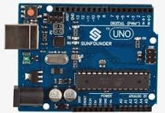
Traffic Light using Arduino
Team Members:
Azmal
Irfan
Adhi
Prakalathan

Slide 2
Abstract
This project aims to simulate a basic traffic light system using Arduino microcontrollers. The system consists of three sets of LED signals representing traffic lights for cars and pedestrians. Through the implementation of Arduino Uno boards and accompanying sensors, the lights will transition based on predefined timing sequences, simulating real-world traffic scenarios.

Slide 3
Objectives
1. Simulation of Traffic Control
2. Educational Purpose
3. Integration of Arduino
4. LED Signal Representation
5. Adjustable Timing
6. Sensor Integration

Slide 4
Reference
1. Arduino Official Website:
The official Arduino website (https://www.arduino.cc/) provides comprehensive documentation, tutorials, and examples for getting started with Arduino boards and projects.
2. Arduino Workshop: A Hands-On Introduction with 65 Projects" by John Boxall

Slide 5
THANK YOU !

